Slide 1

HR ANALYTICS
project Name : Employee Retention
Sub : KPI’s
BY:- Ankita Anand

Slide 2

Excel Analysis
Average Attrition rate for all Departments
Average Hourly rate of Male Research Scientist
Attrition rate Vs Monthly income stats
Average working years for each Department
Job Role Vs Work life balance
Attrition rate Vs Year since last promotion relation

Slide 3
KPI 1-Average Attrition Rate Department Wise

Slide 4
KPI 2-Average Hourly Rate for Male Research Scientist

Slide 5
KPI 3- Attrition rate Vs Monthly income stats

Slide 6
KPI 4-Average working years for each Department

Slide 7
KPI 5- 1) Job Role Vs Work life balance

Slide 8
KPI 5- 2) Job Role Vs Work life balance

Slide 9
Attrition rate Vs Year since last promotion relation

Slide 10

SQL Analysis

Slide 11
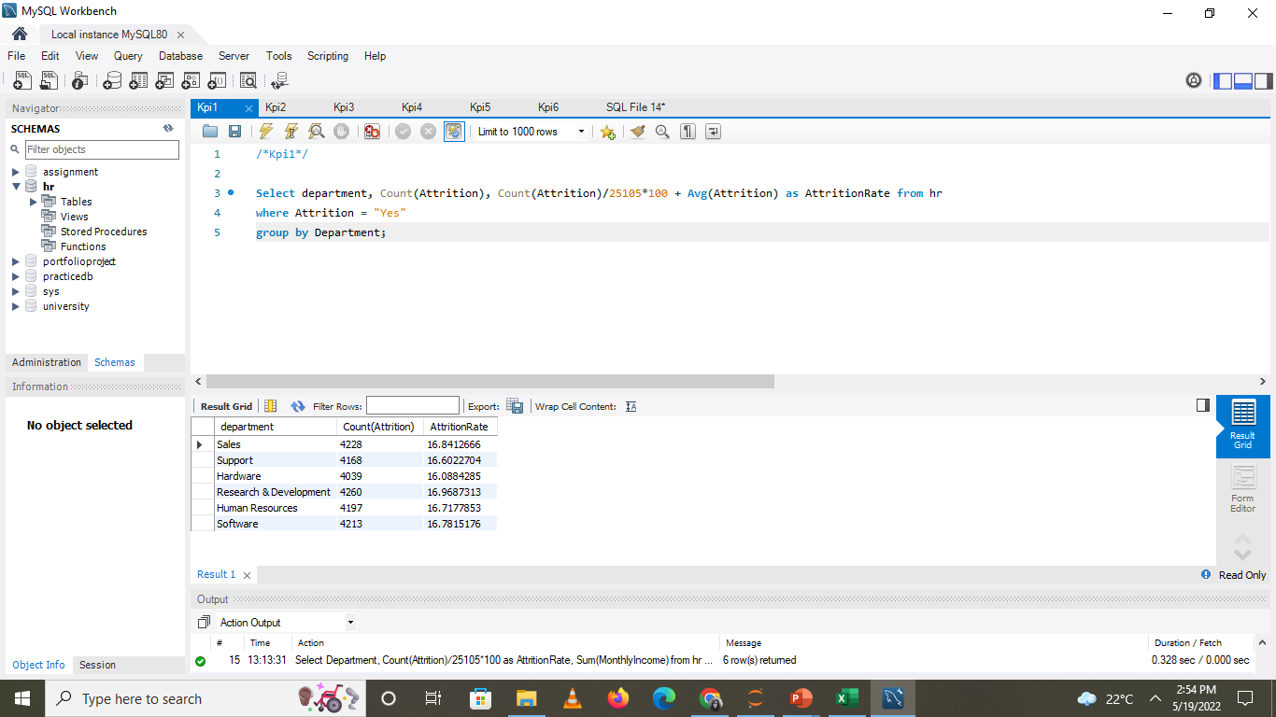
KPI 1- Average Attrition Rate Department Wise

Slide 12
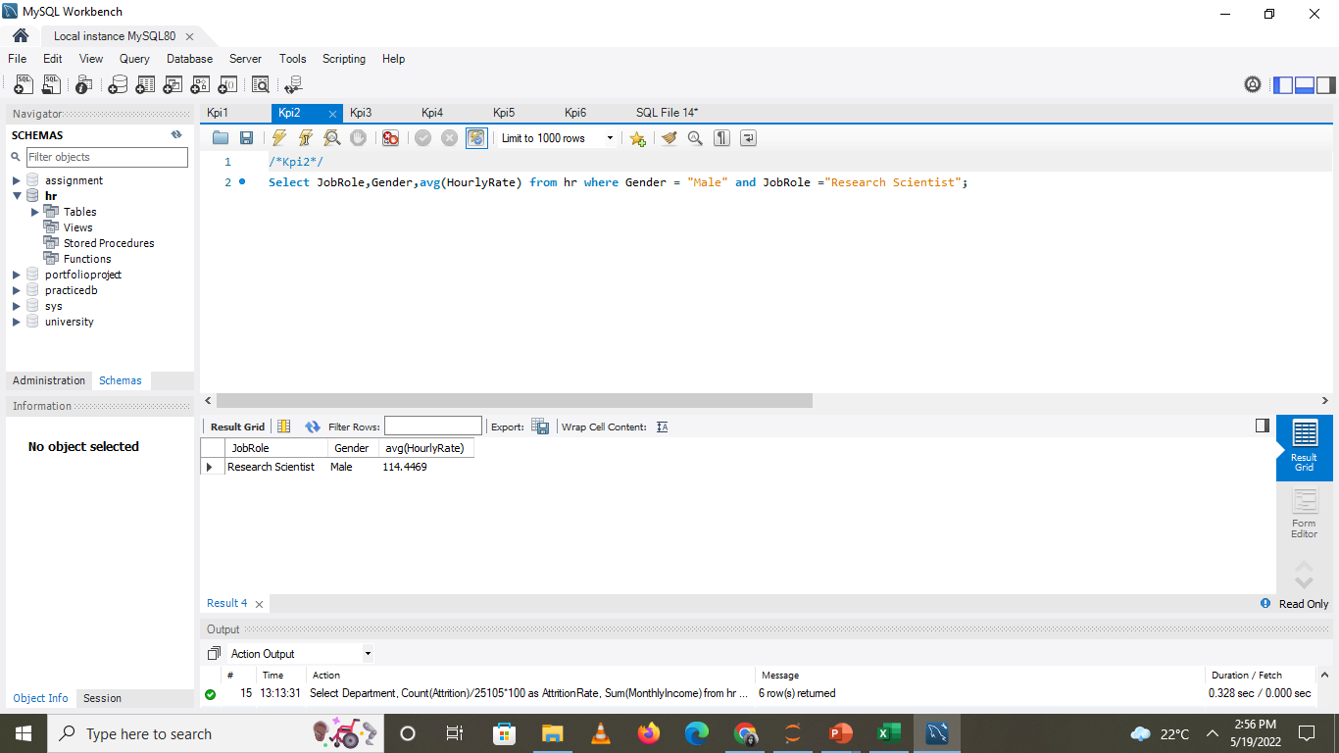
KPI 2-Average Hourly Rate for Male Research Scientist

Slide 13
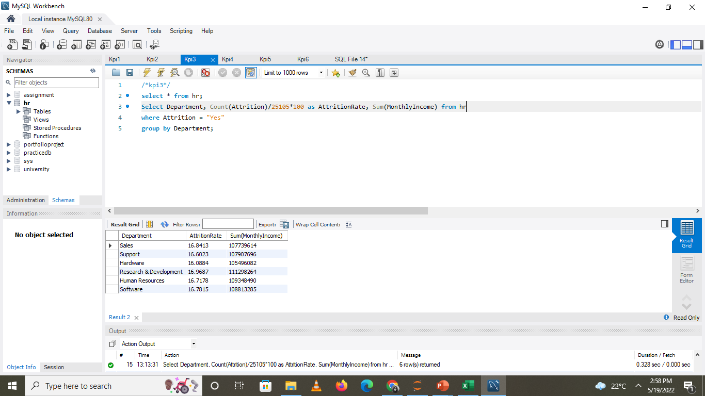
KPI 3- Attrition rate Vs Monthly income stats

Slide 14
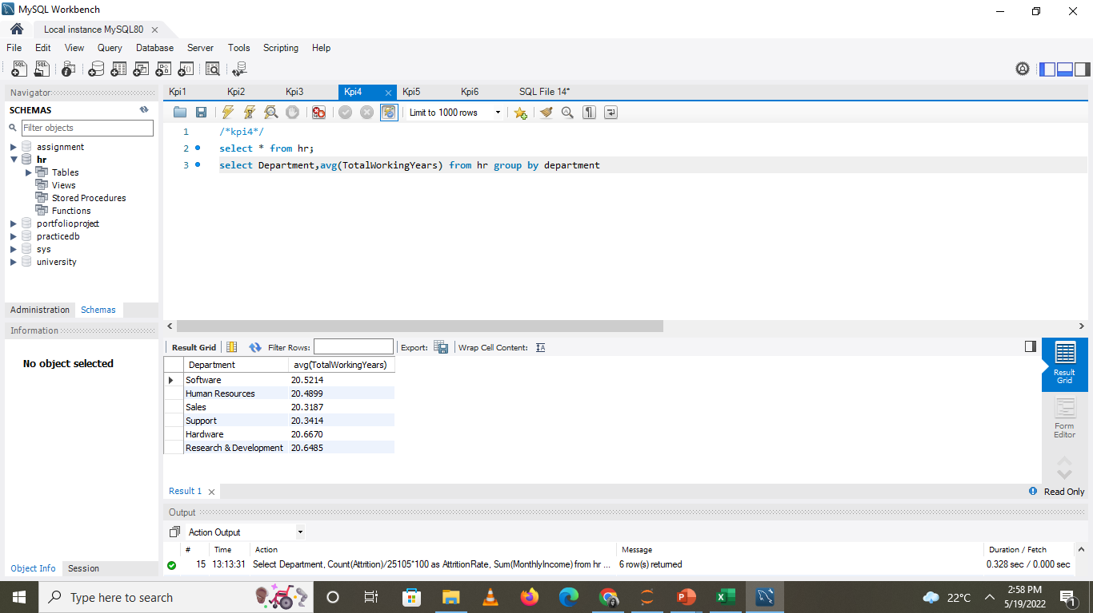
KPI 4-Average working years for each Department

Slide 15
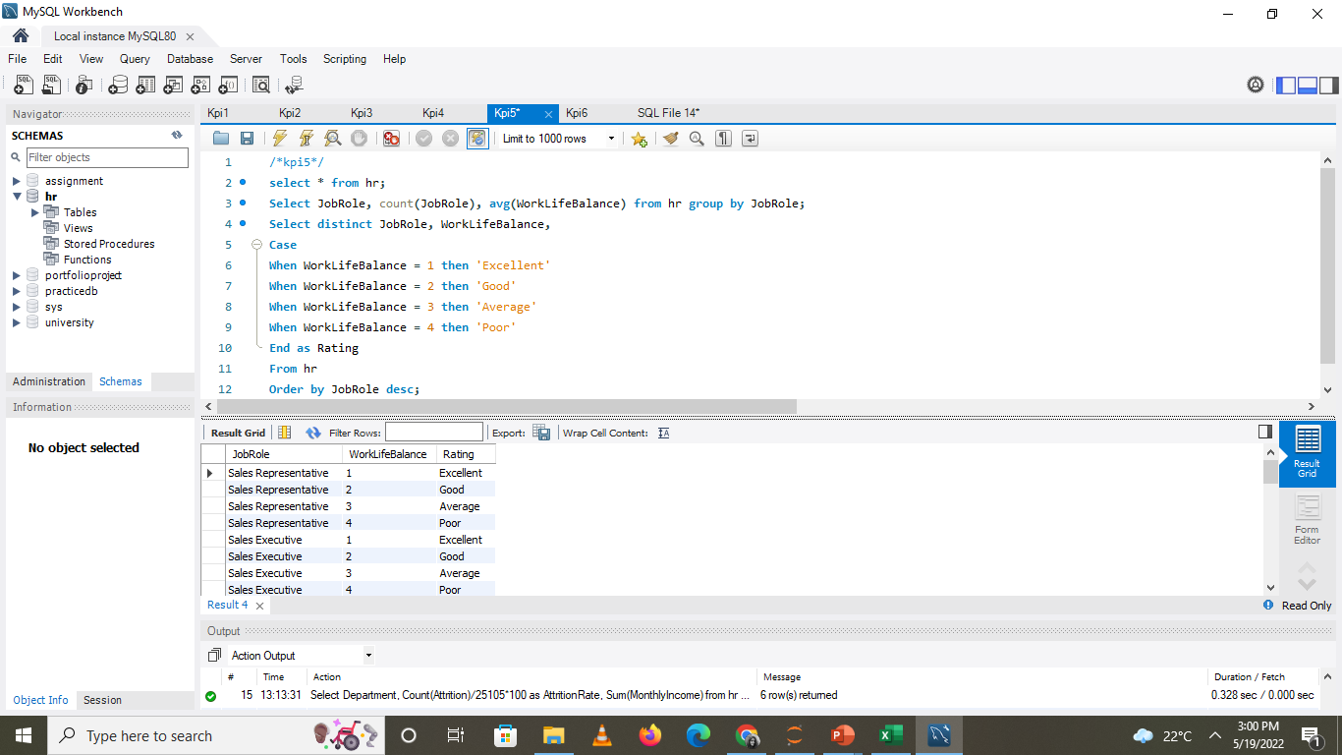
KPI 5- Job Role Vs Work life balance

Slide 16
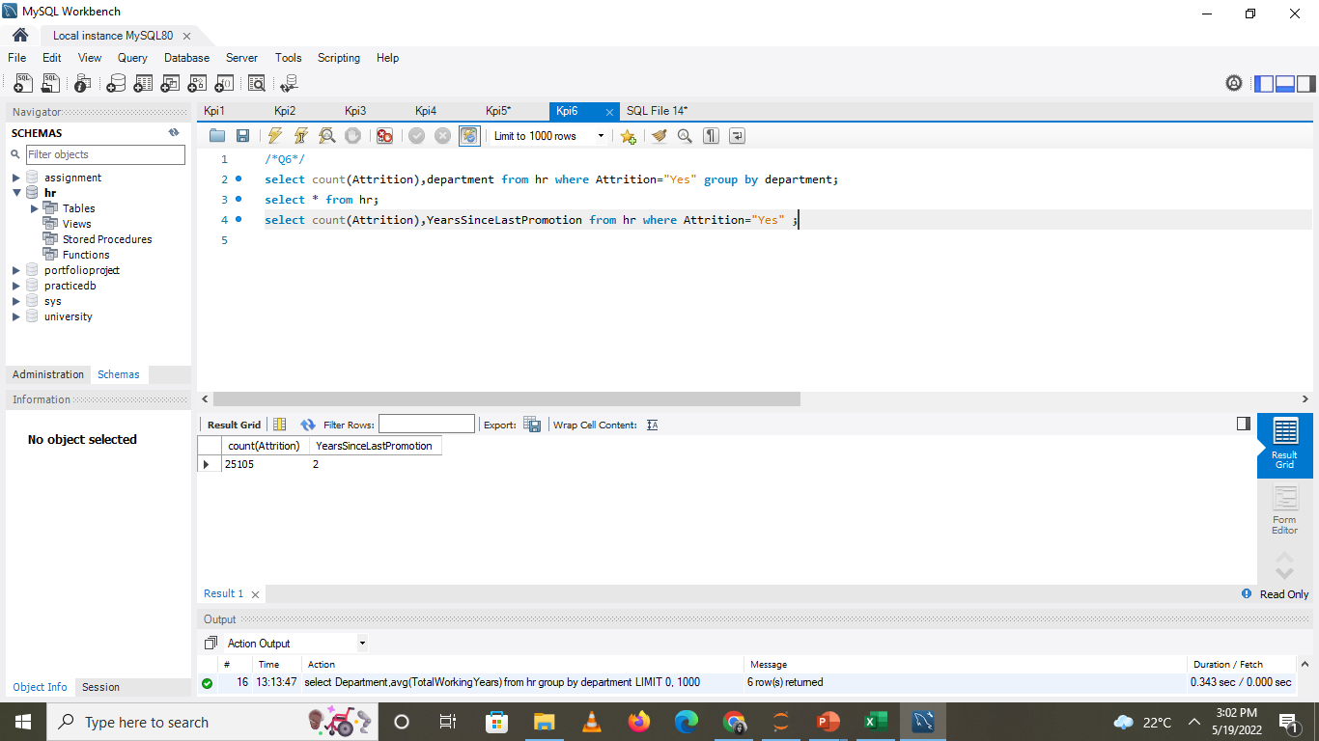
KPI 6-Attrition rate Vs Year since last promotion relation

Slide 17
Thank You

